Slide 1
Introduction to Computing for Data Analysis
Linear regression
Richard Vuduc, Ph.D.
Associate Professor
School of Computational Science and Engineering
Multiple regression and matrices
Notes:
This lesson is about multiple linear regression, which we’ll formulate using – surprise, surprise – the language of linear algebra.
You use multiple regression when the model you want to build is linear in more than one predictor.

Slide 2
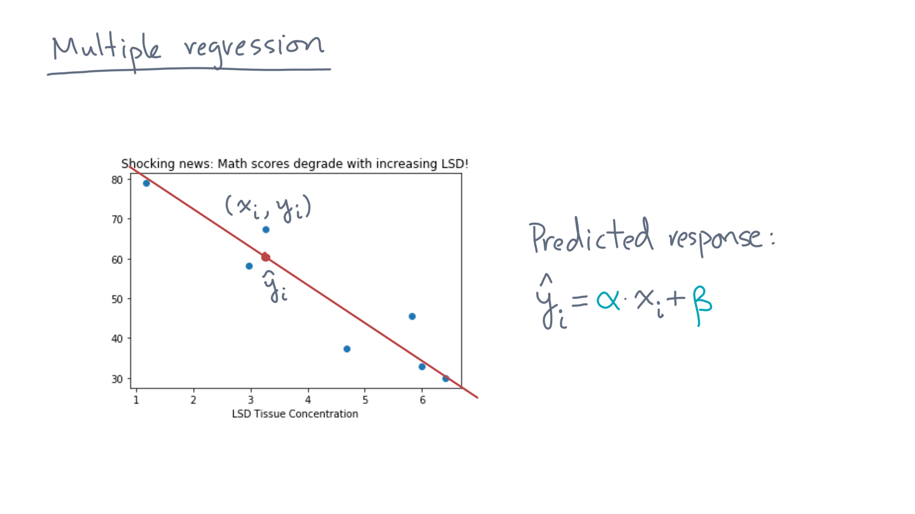
Notes:
That is, so far we’ve only considered the example of a single predictor, like LSD tissue concentration, producing estimates for a single response, in this case, exam score.

Slide 3
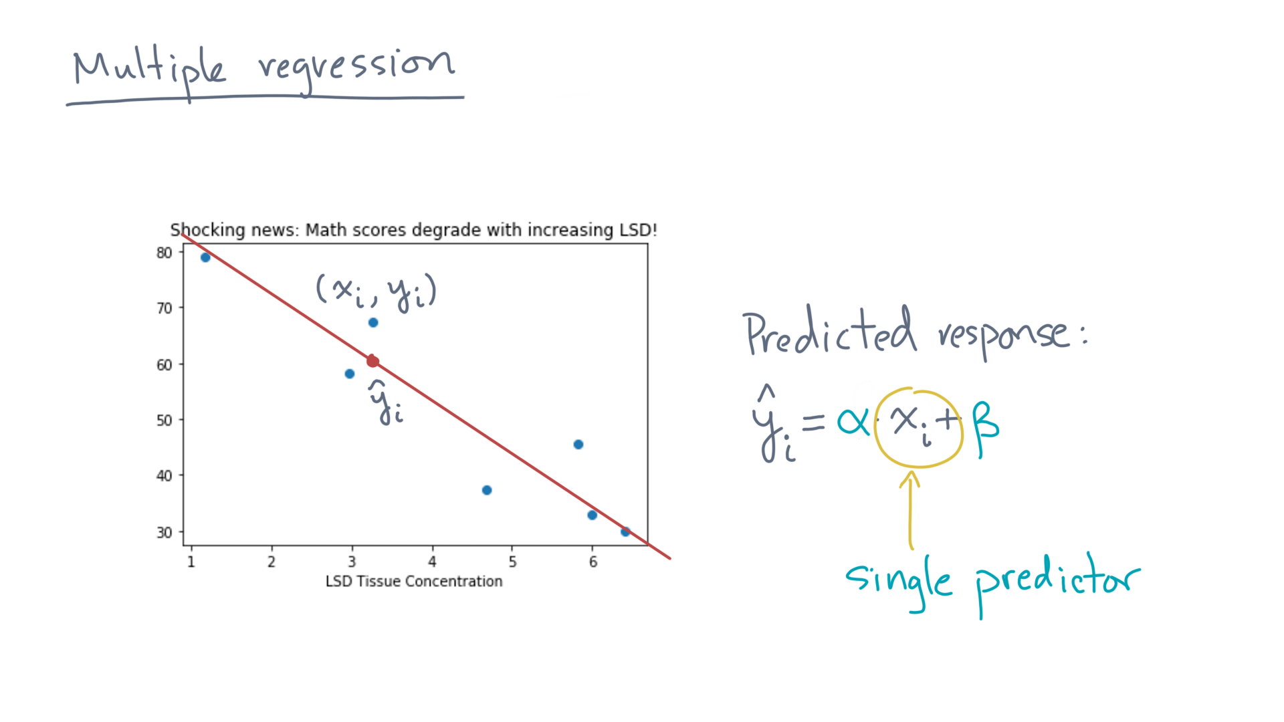
Notes:
But real datasets typically have multiple candidate predictors.

Slide 4
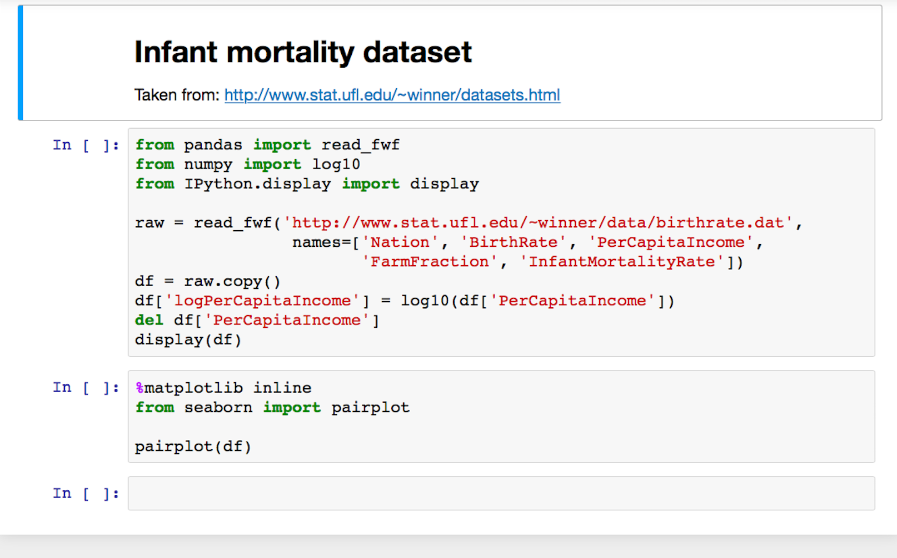
Notes:
For instance, let’s peek at another dataset.

Slide 5
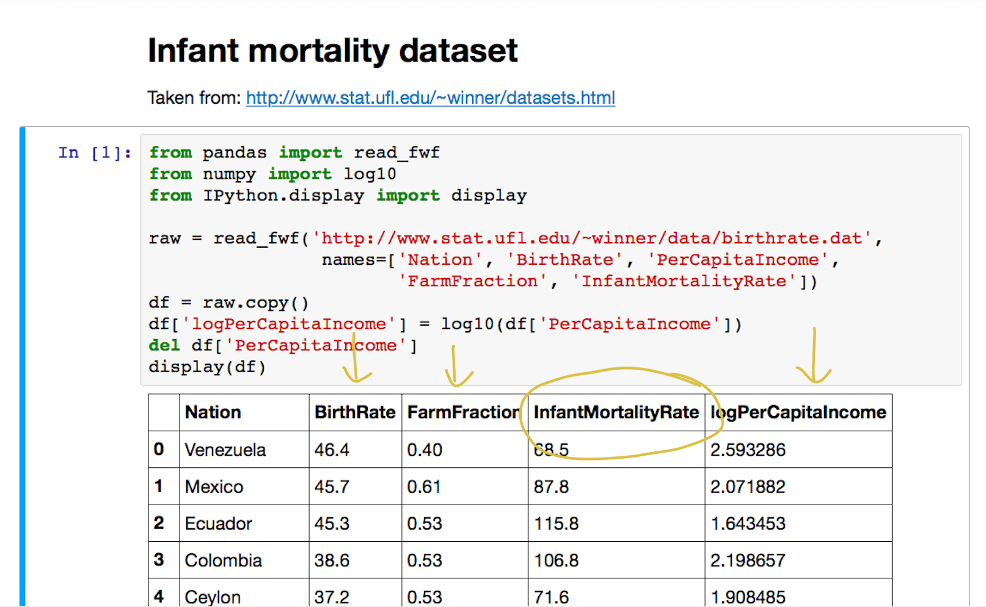
Notes:
This tibble measures, among various countries, the infant mortality rate along with other economic indicators, like birth rate, the fraction of the population engaged in agricultural work, and the log-base-ten of per capita income.

Slide 6
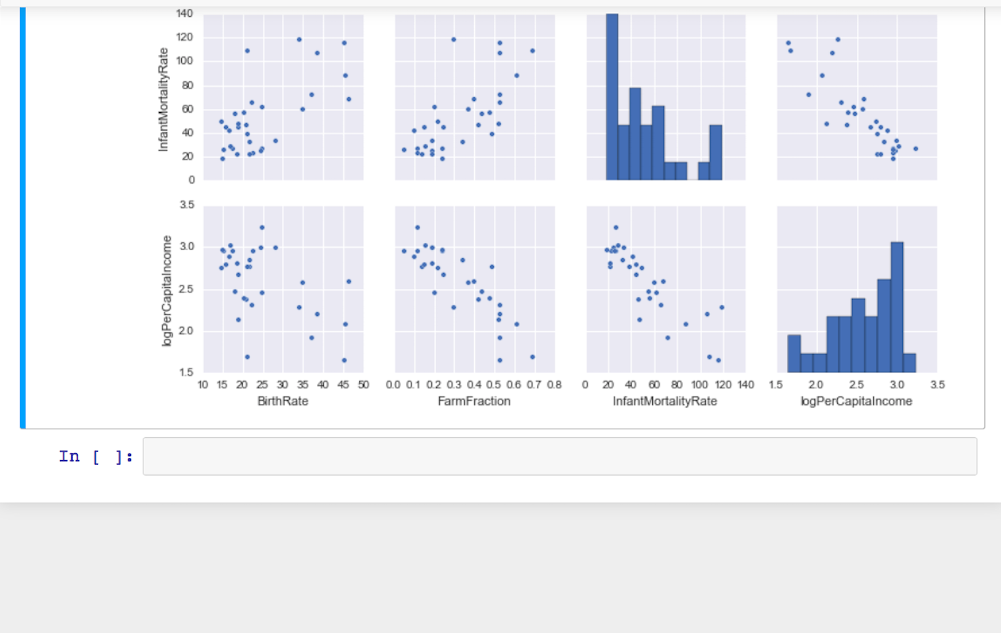
Notes:
Here’s a picture.

Slide 7
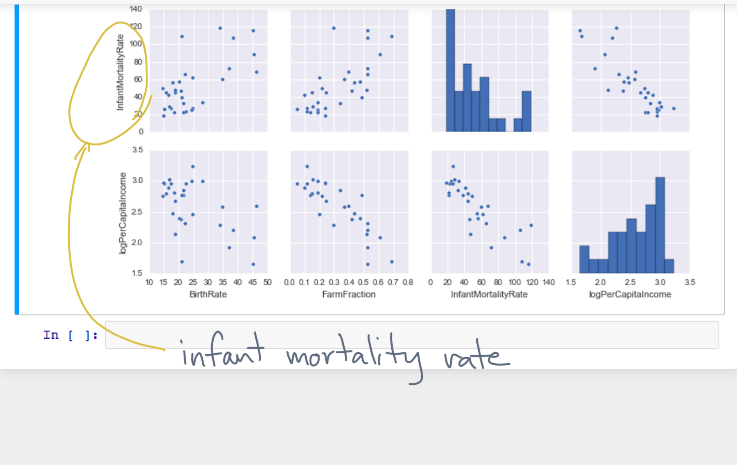
Notes:
Consider the infant mortality rate shown here.

Slide 8

Notes:
Viewing birth rate, farming fraction, and log-income as predictors, it looks they all might have a linear effect on infant mortality.

Slide 9
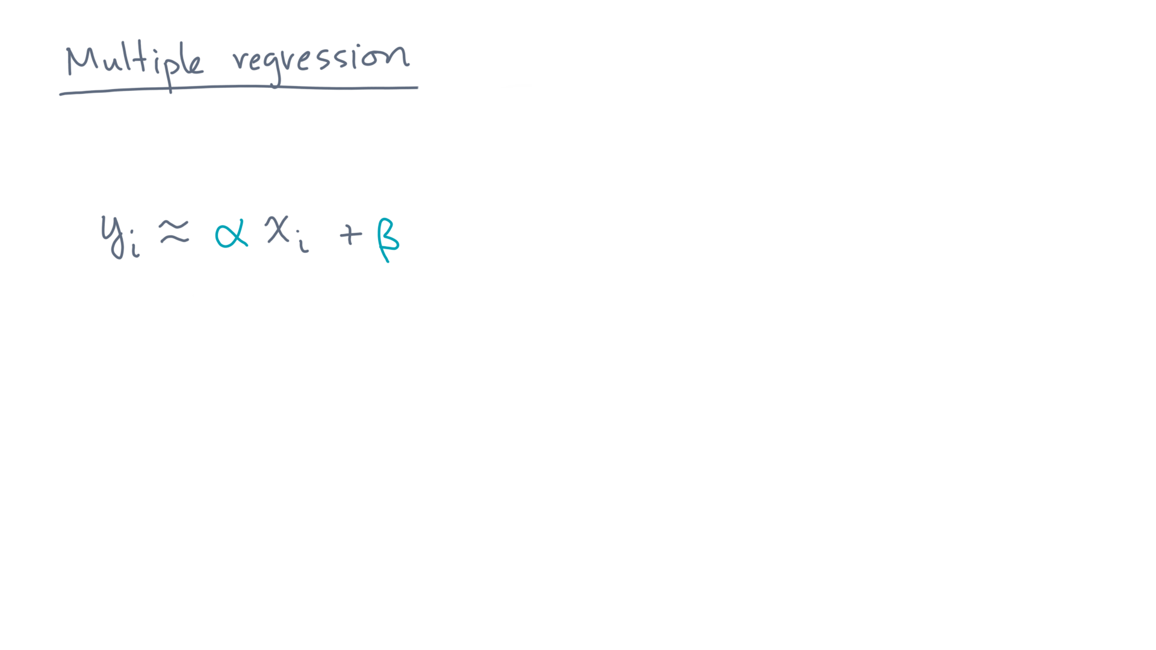
Notes:
With a single predictor, recall the linear model.

Slide 10
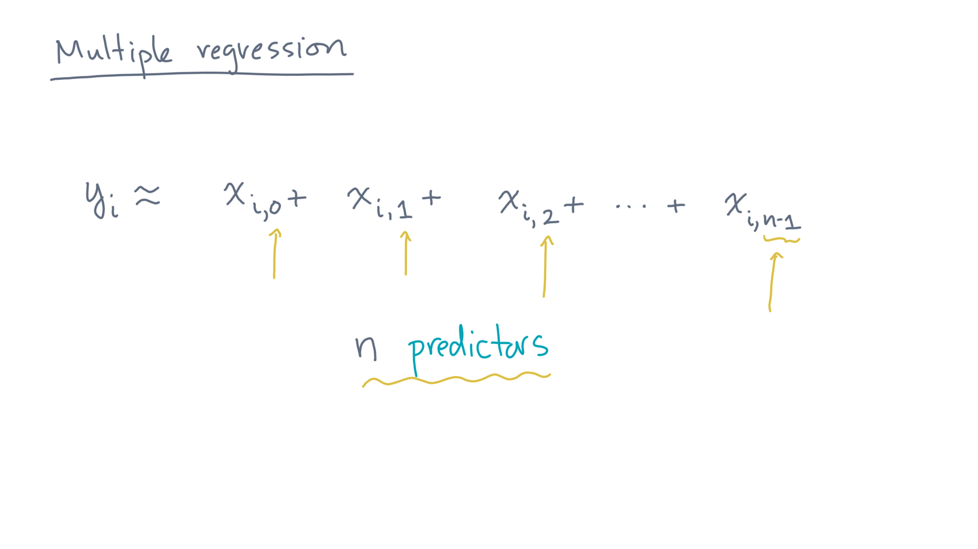
Notes:
In the multiple predictor case, there will be one term for each of the, say, “n” predictors.
For the i-th observation, let’s name these x-eye-zero, x-eye-one, x-eye-two, and so on, up to x-eye-n-minus-one.

Slide 11
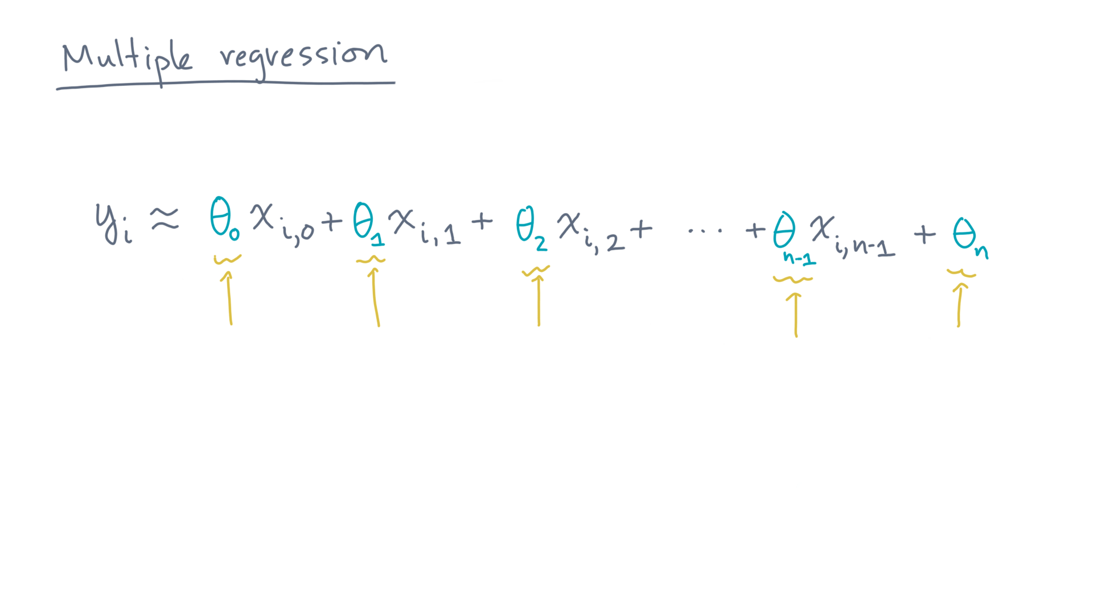
Notes:
Each of these is scaled by a model coefficient.
Let’s name these coefficients theta-zero through theta-n-minus-1.
And let’s also include a general intercept parameter, named theta-n.

Slide 12
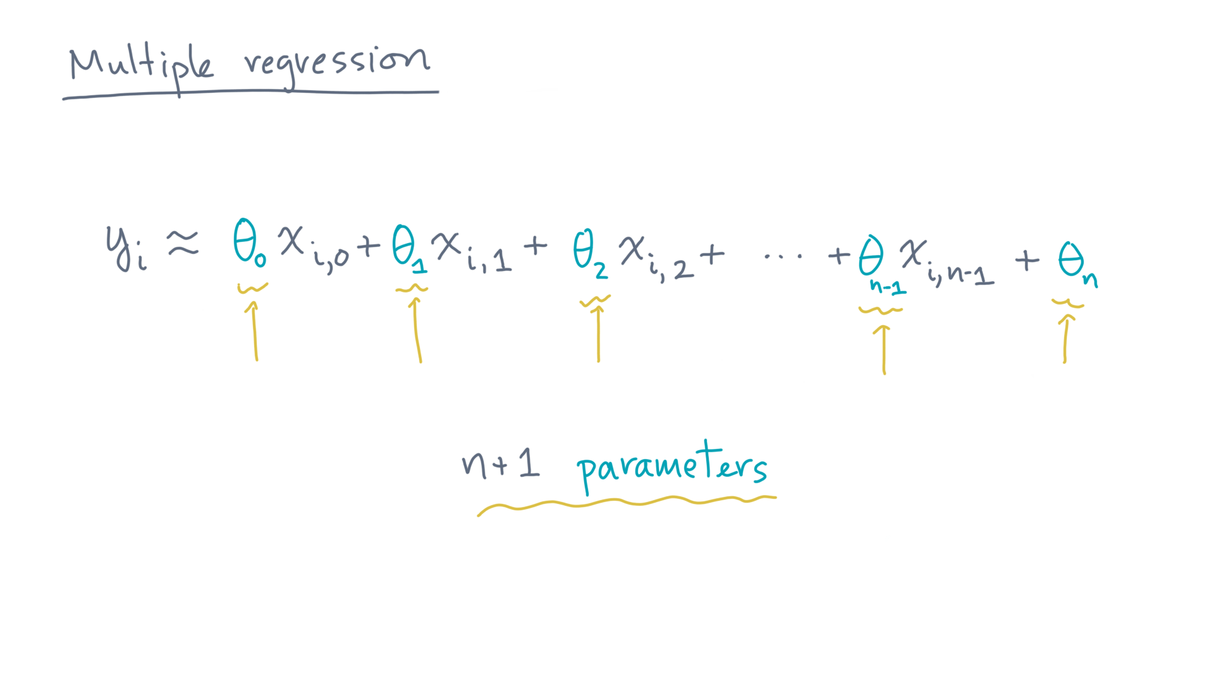
Notes:
That’s a total of n plus 1 model parameters.

Slide 13
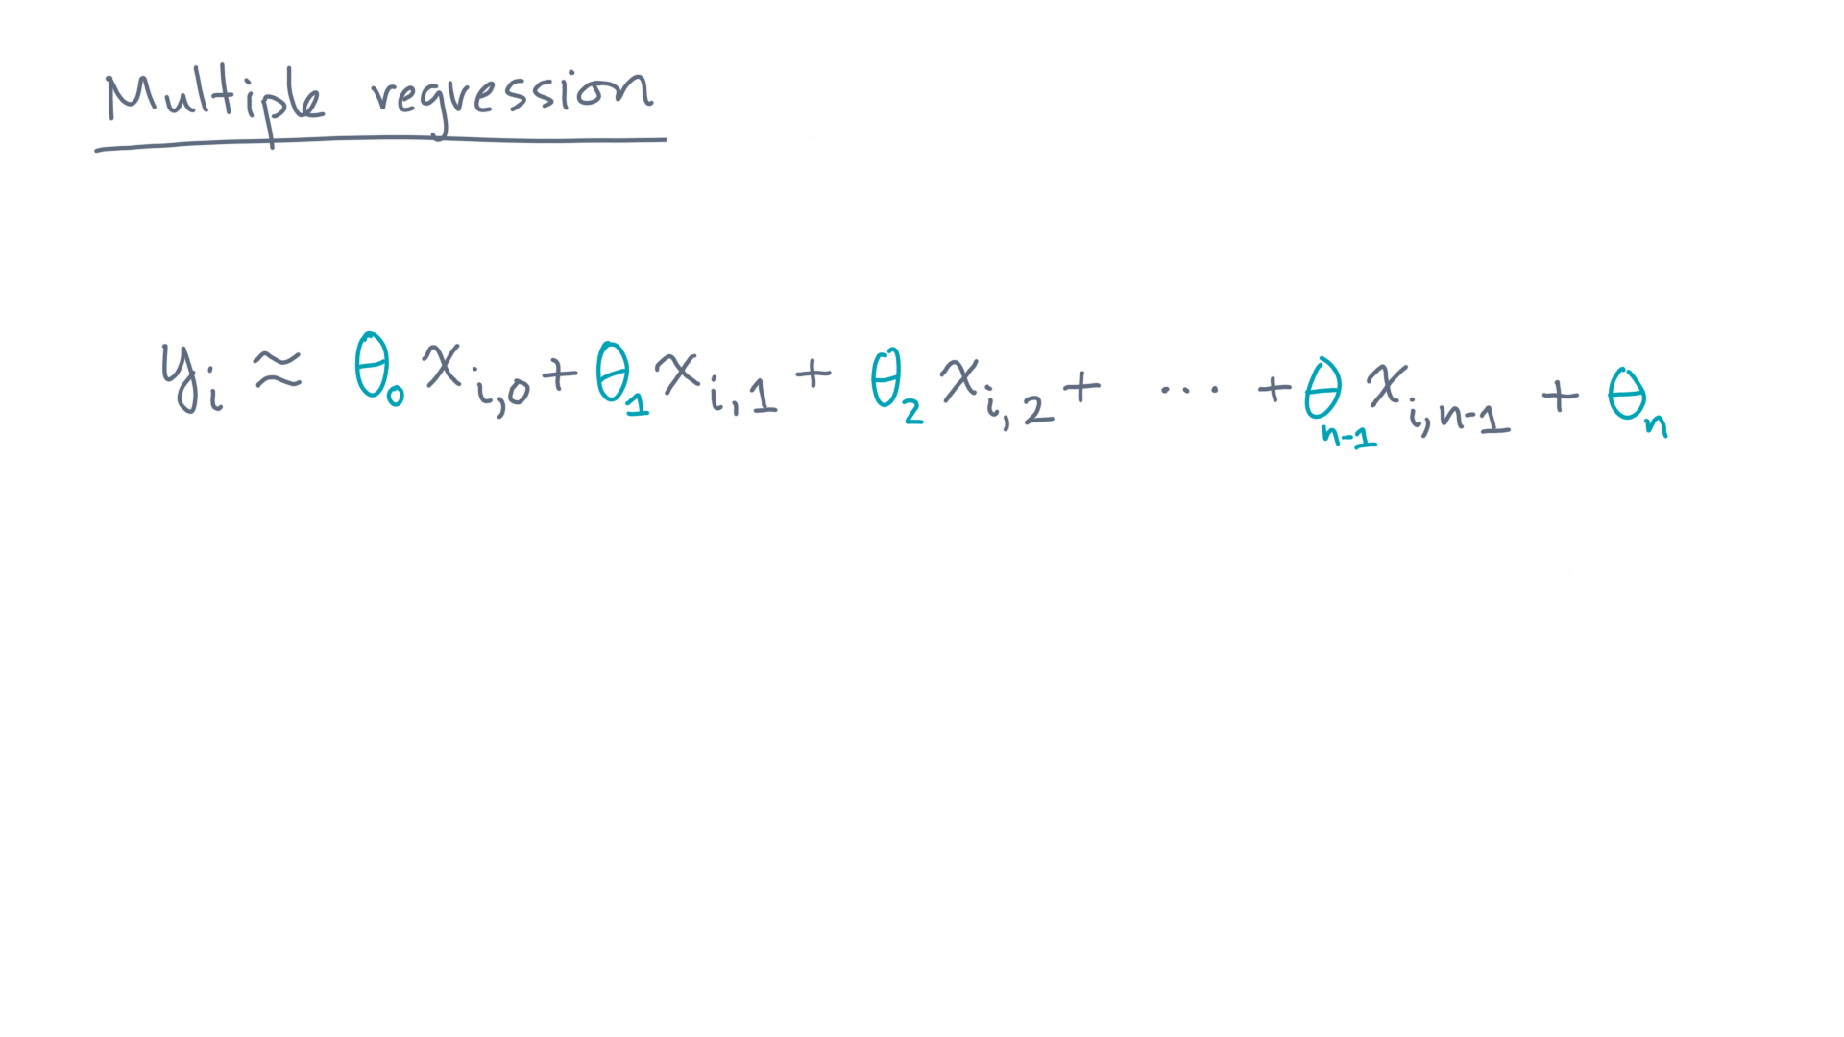
Notes:
We want a model that holds for all observations “eye.”
You can state that more compactly as follows.

Slide 14
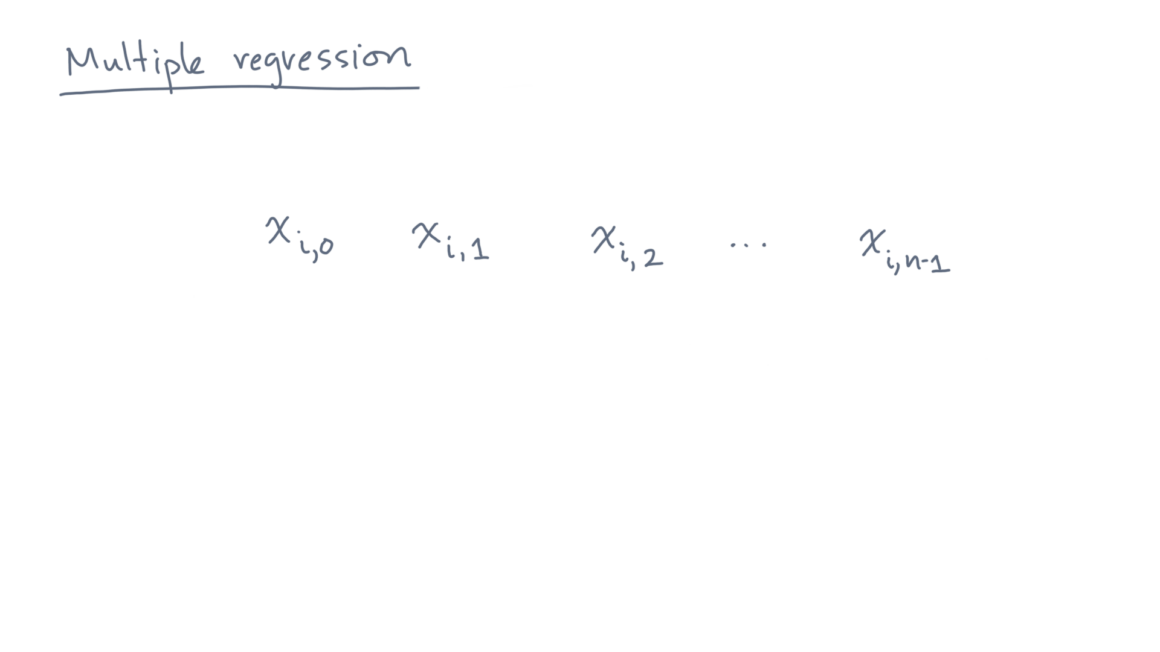
Notes:
Consider the observed predictor values of the i-th observation.

Slide 15
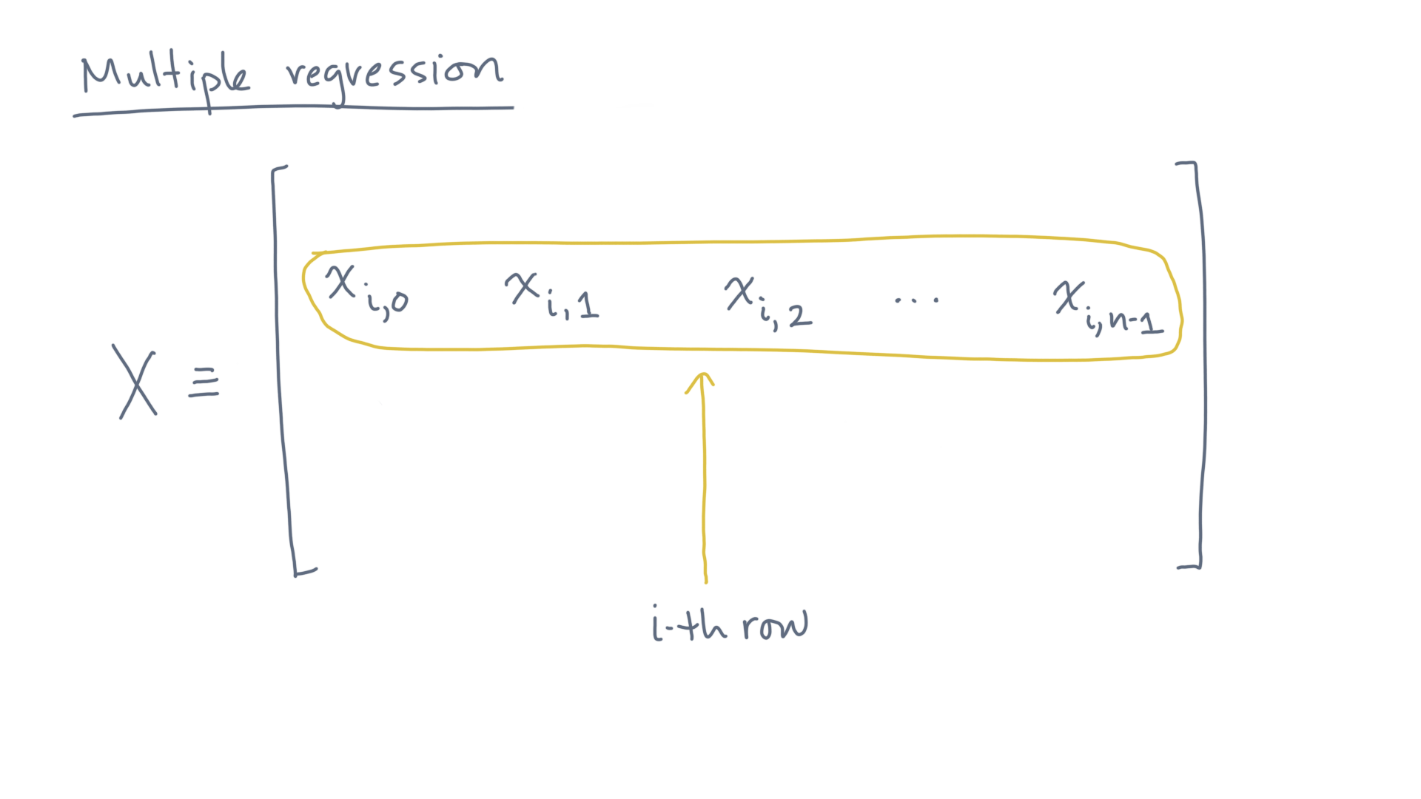
Notes:
You can think of these as elements of row-eye of a matrix, capital X.

Slide 16
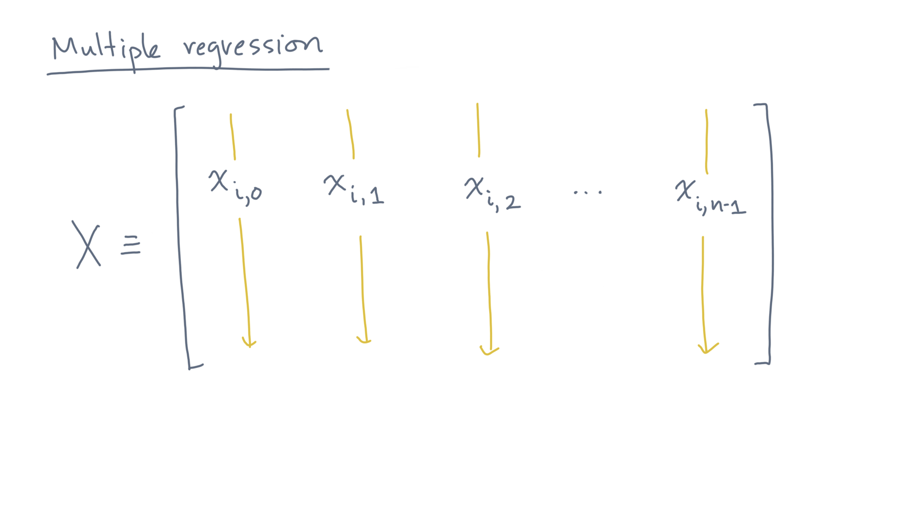
Notes:
You can also think of capital-X as a tibble, since each column is the set of observations of some variable or predictor.
Now, let’s adopt the following convention.

Slide 17
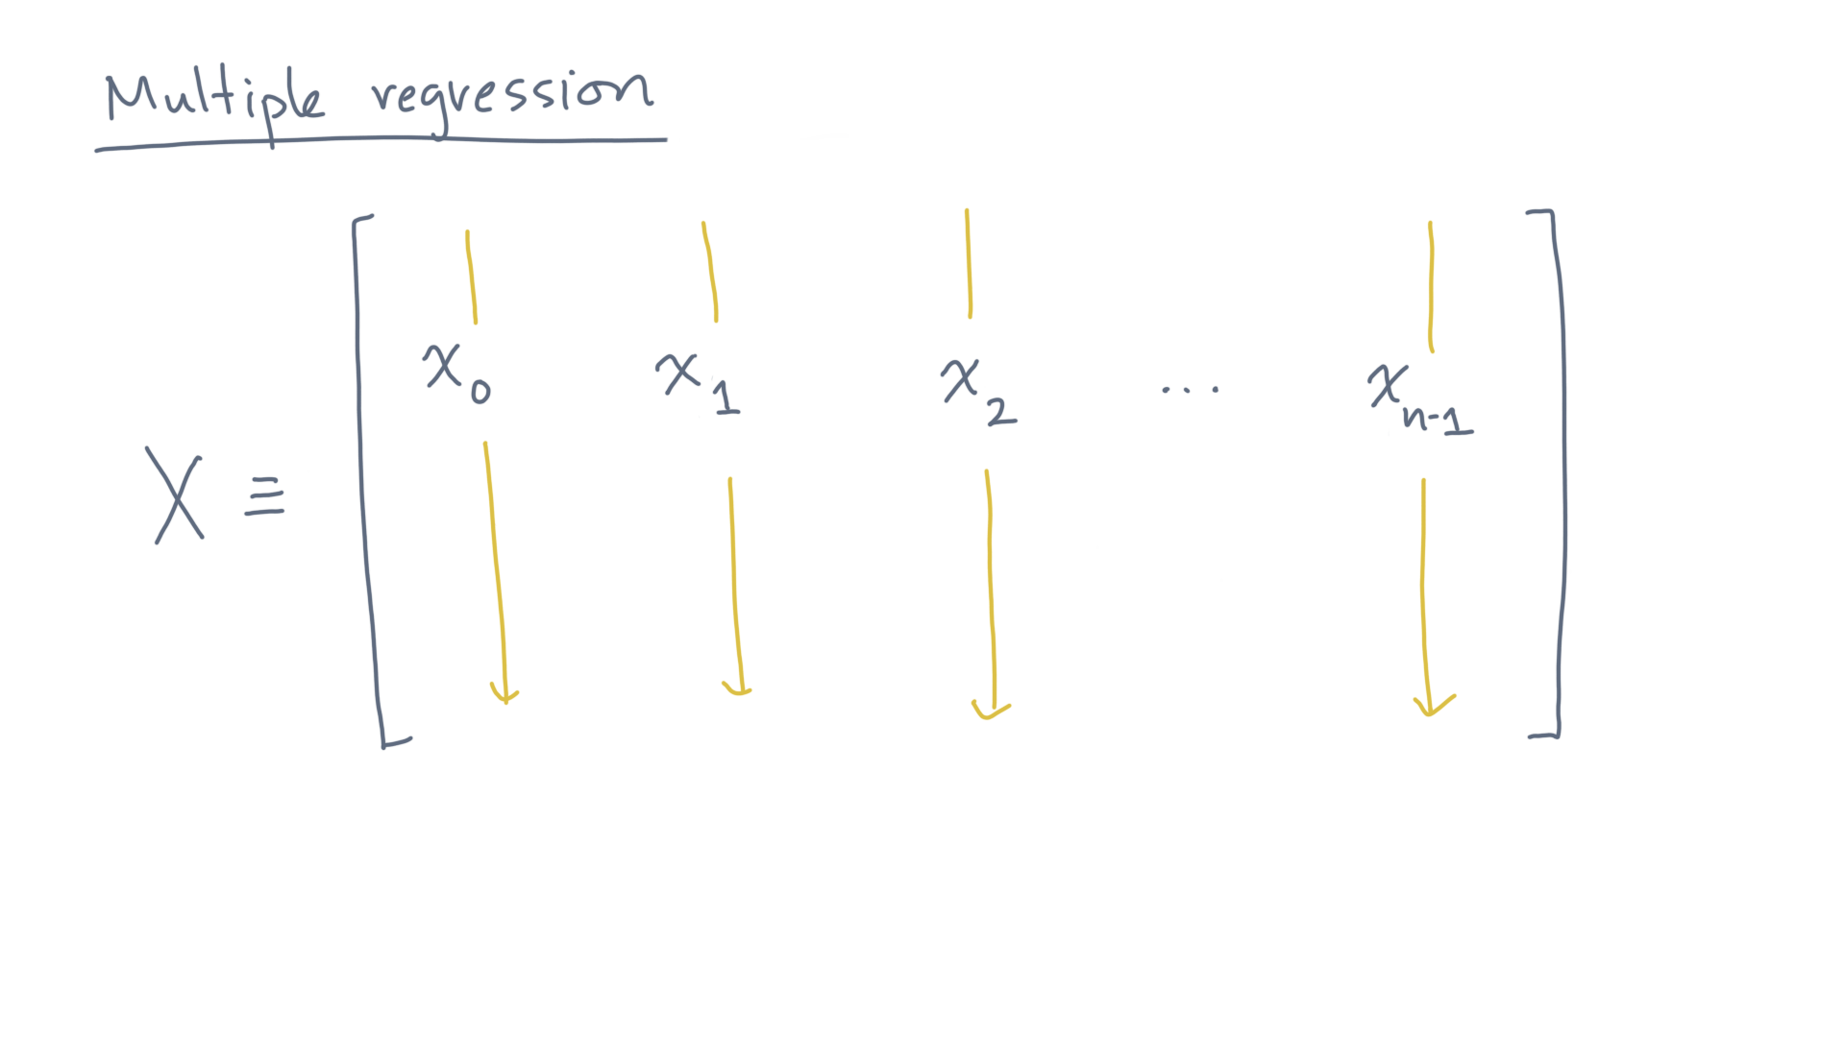
Notes:
Let little x-zero through little x-n-minus-1, that is, with a single index, denote the *columns* (or *predictors*) of this matrix X.

Slide 18
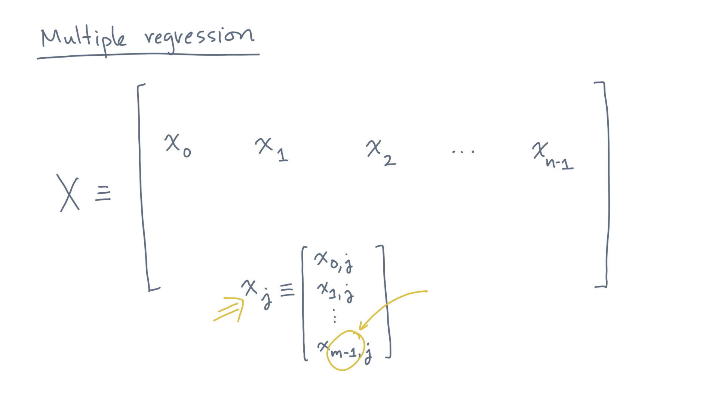
Notes:
That is, a column x-jay is the vector of “em” observations for predictor jay.

Slide 19
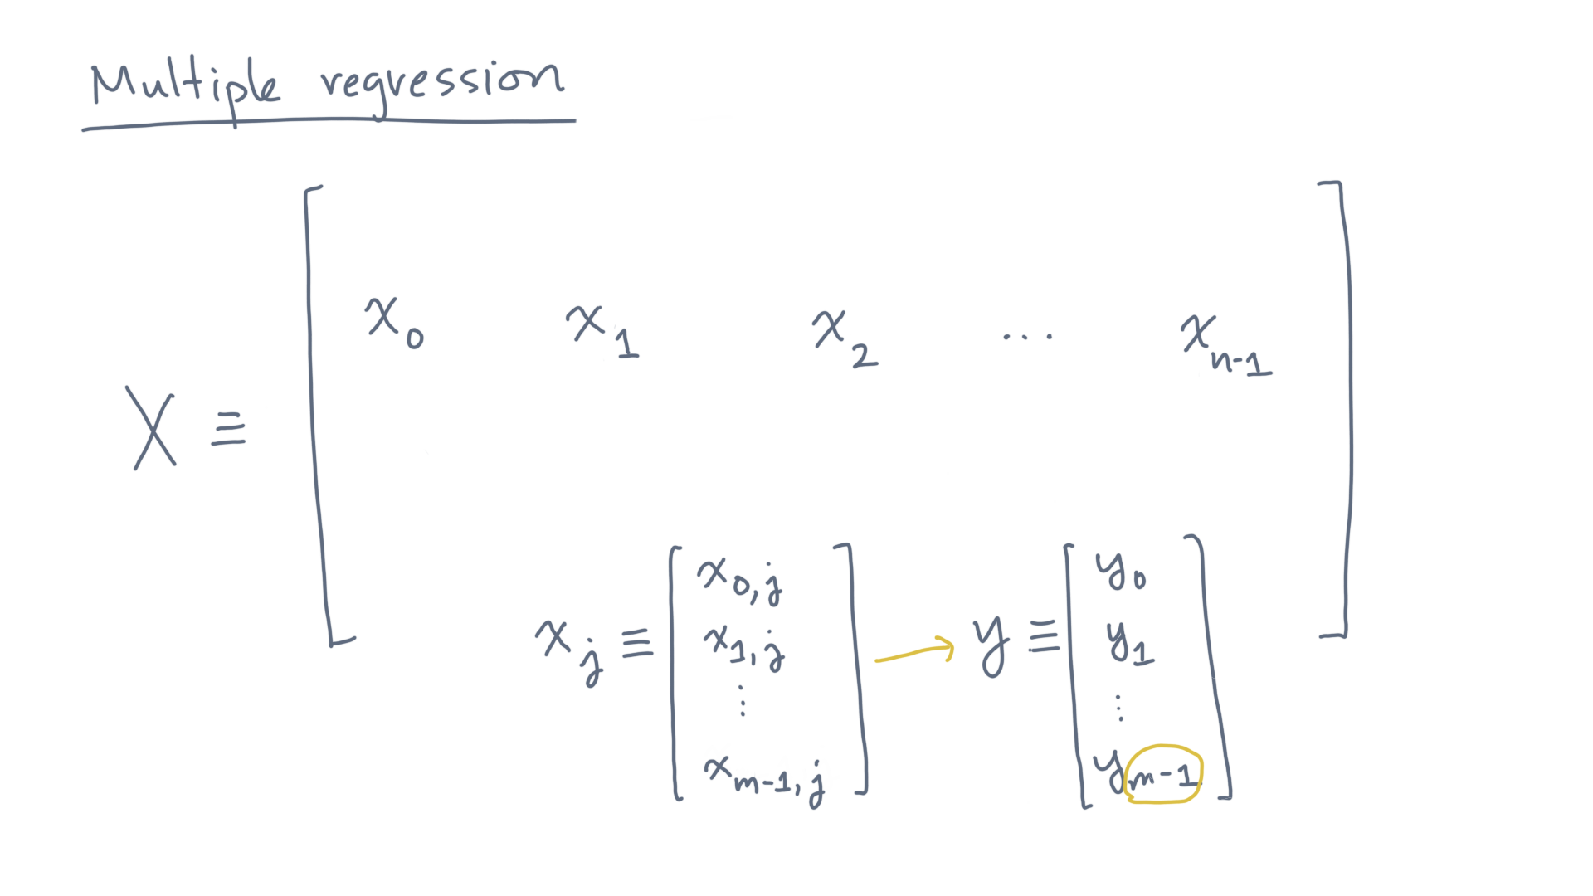
Notes:
Similarly, let y be the column vector of “m” responses.

Slide 20
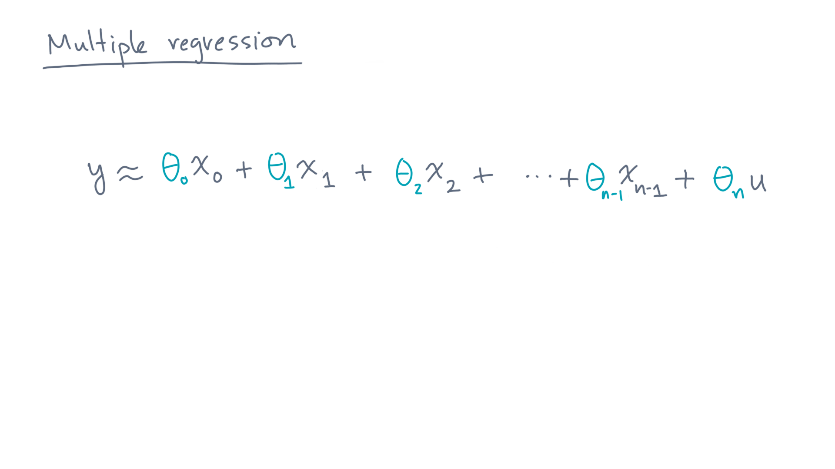
Notes:
Then the model can be written in this form:
The response vector is, approximately, a linear combination of the predictors.

Slide 21
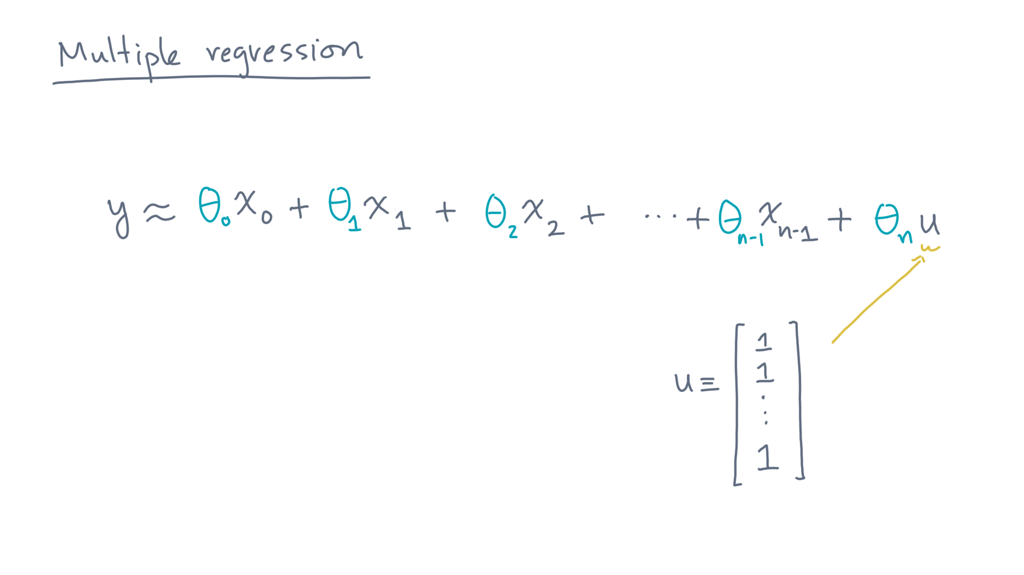
Notes:
Here, the vector “u”, which appears in the last term multiplying theta-en, is the vector of all ones.

Slide 22
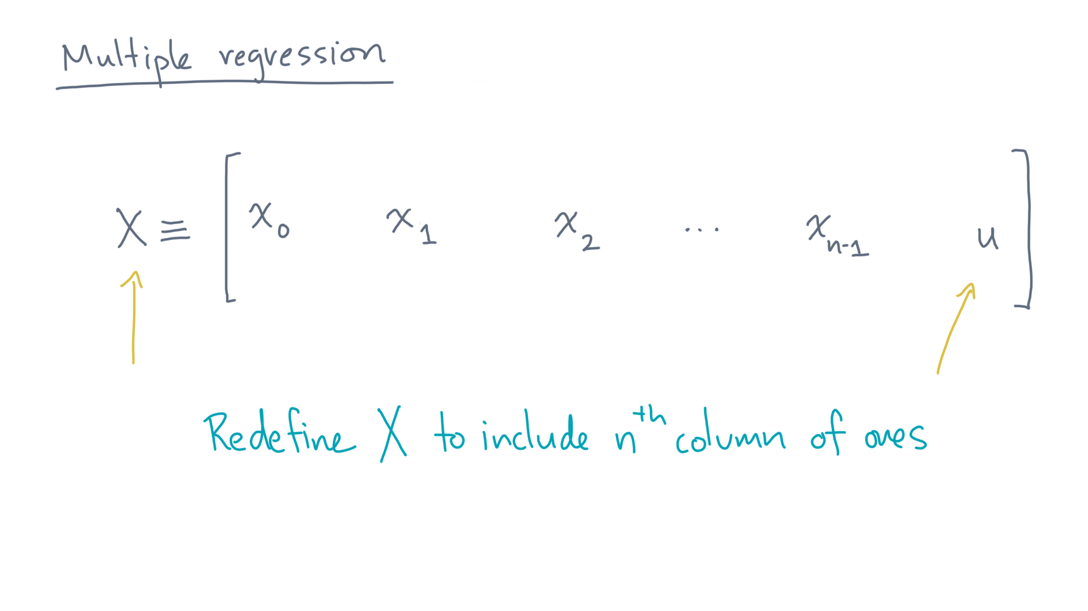
Notes:
Indeed, it will be convenient to *redefine* the matrix capital-X to include this extra column.
With that convention, the model becomes even simpler:

Slide 23
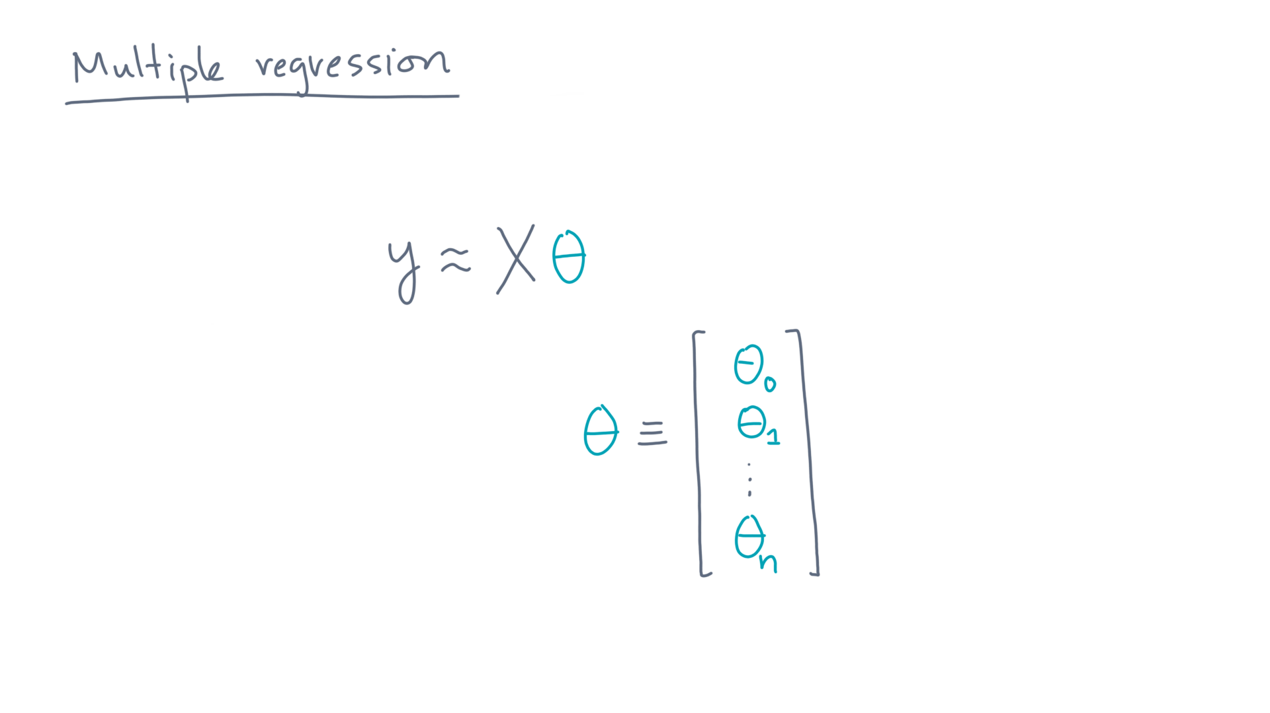
Notes:
Y is X times theta, where theta is the vector of parameters!

Slide 24
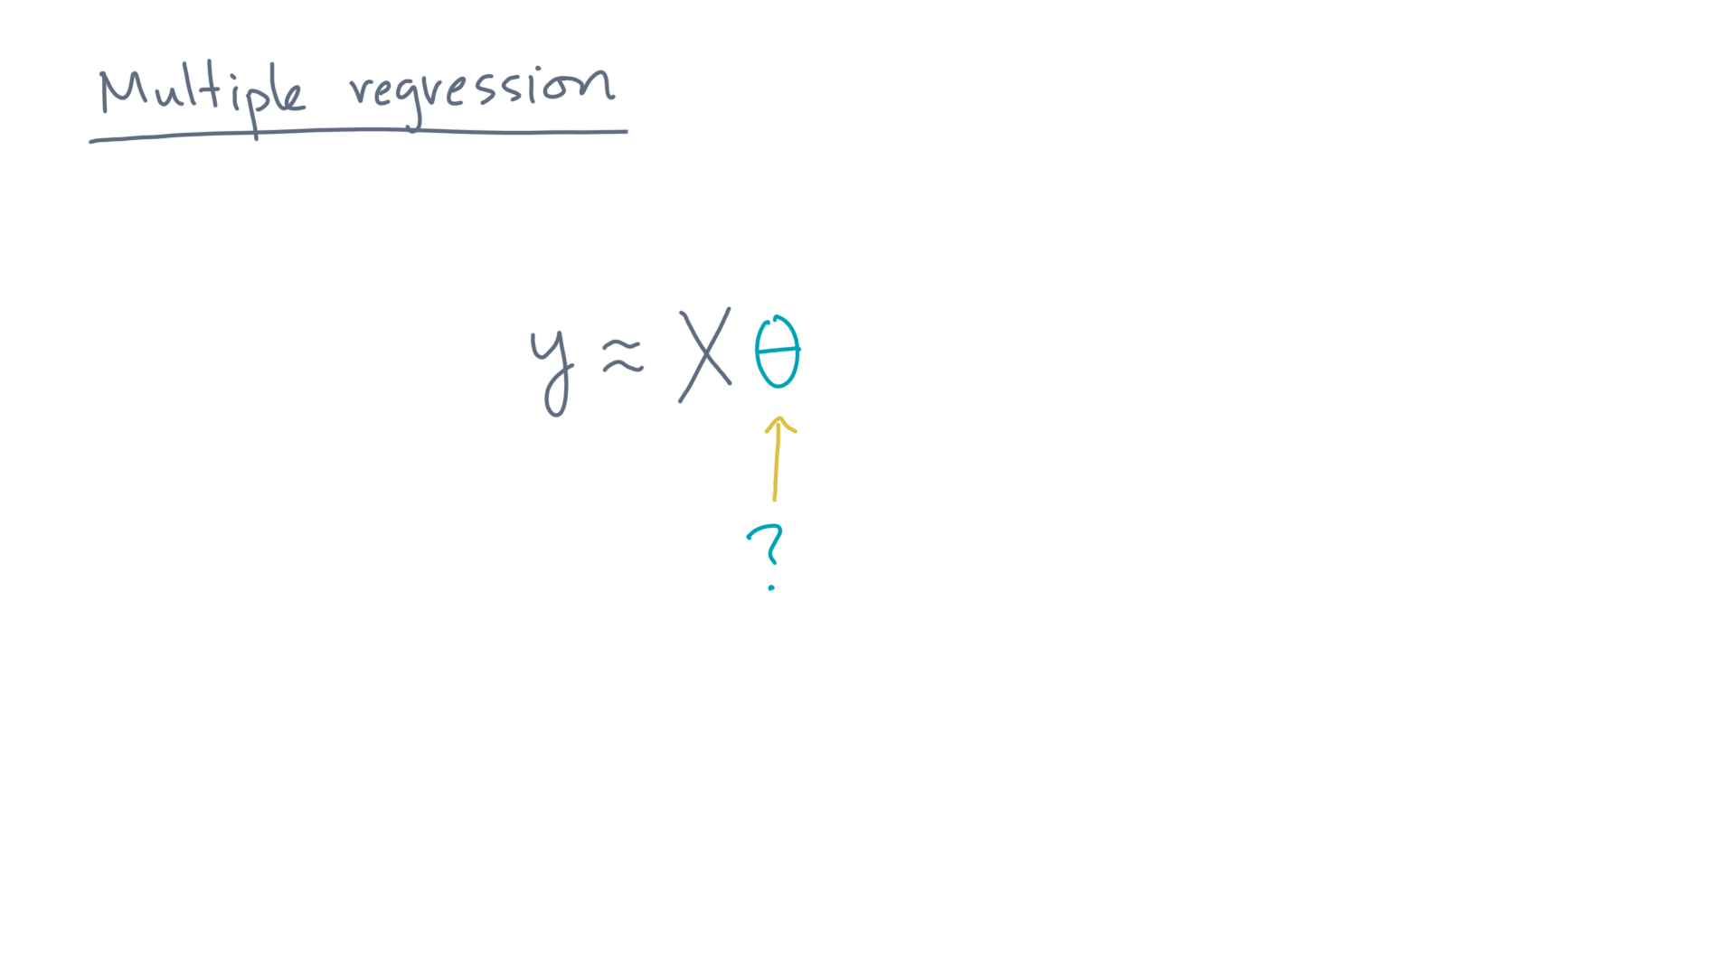
Notes:
Now the next question is how to choose theta.

Slide 25
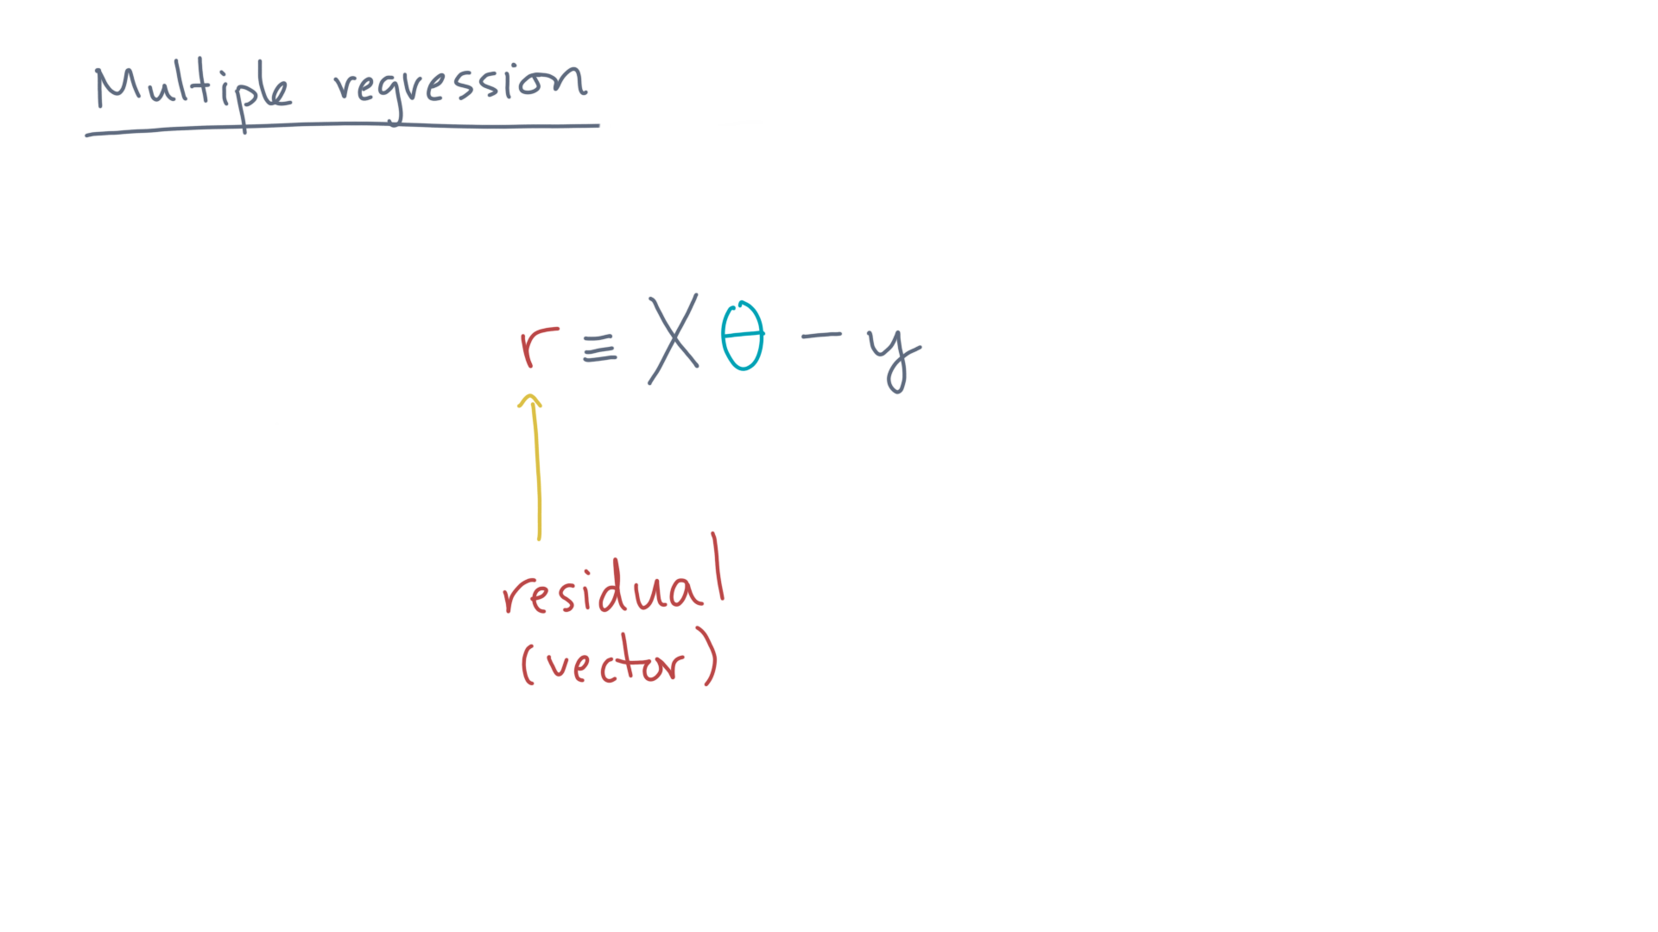
Notes:
Just as before, let’s define the residual vector, r, to be the model’s predicted response, capital-X times theta, minus the observed response, y.

Slide 26
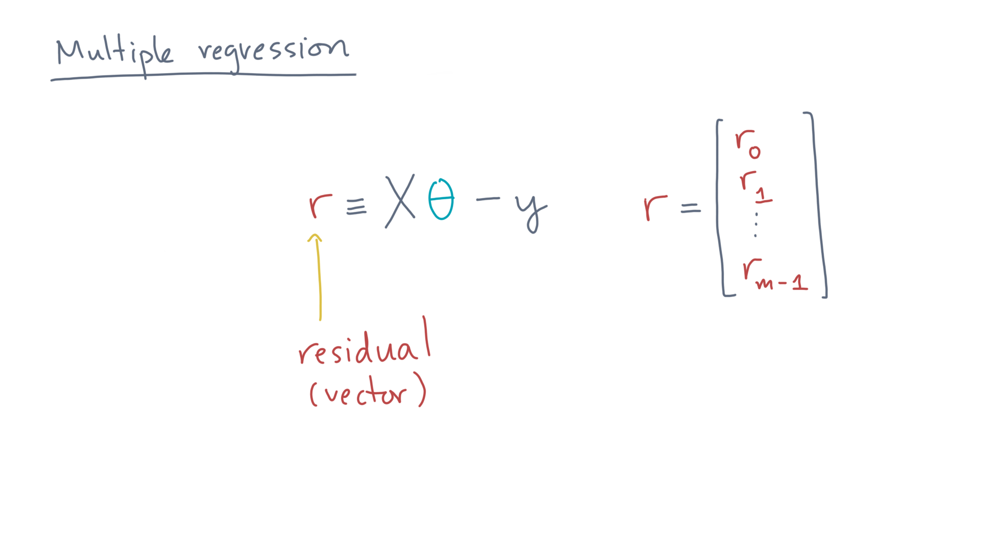
Notes:
The components of “r” are the residuals for each of the “m” observations.

Slide 27
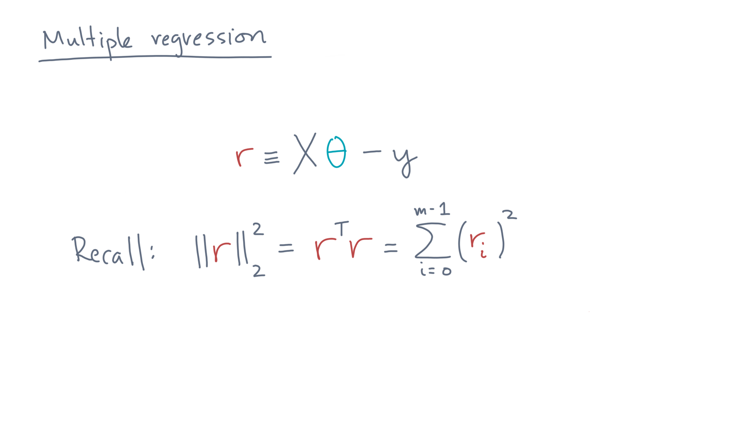
Notes:
Now, recall that the two-norm-squared of “r” is the same as r-transpose-r, which in turn is the same as the sum-of-squared elements of “r”.

Slide 28
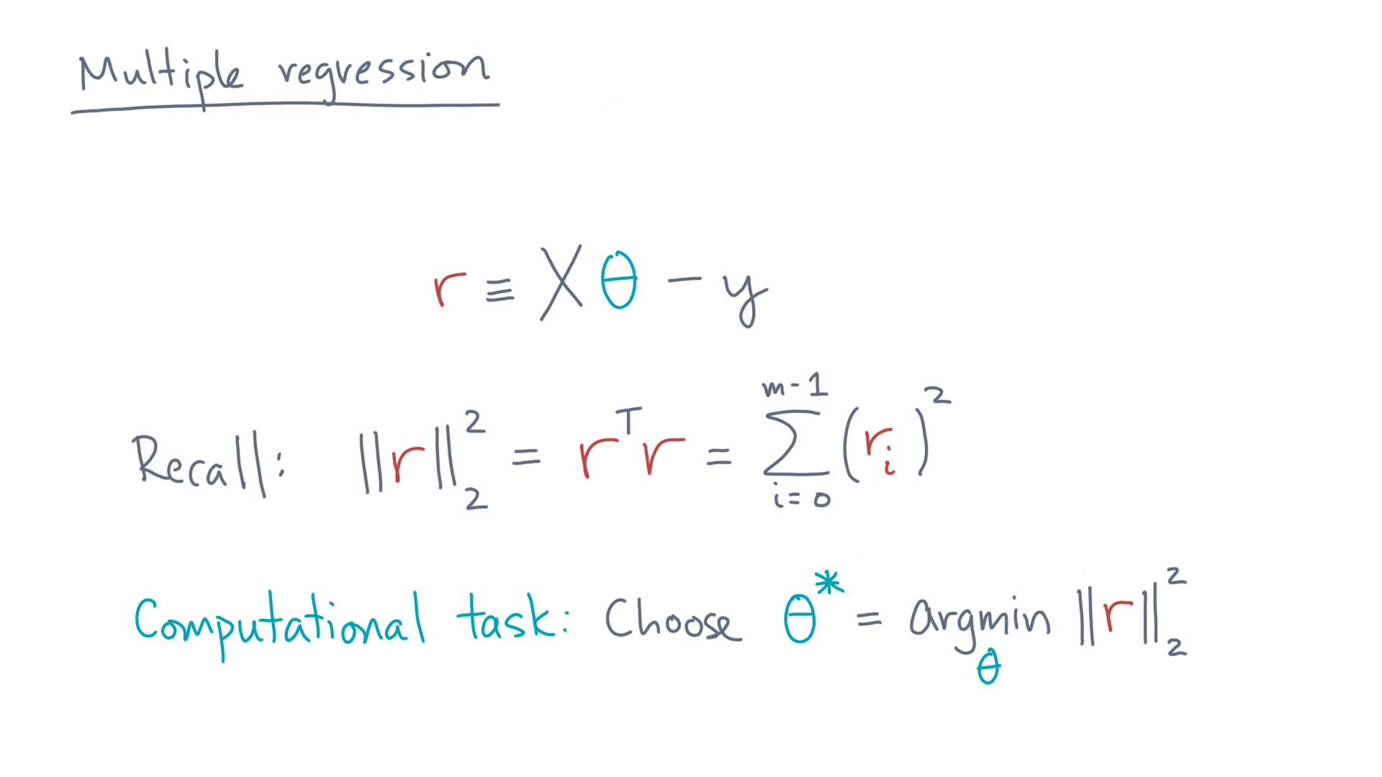
Notes:
Therefore, we can define our computational task as choosing the value of theta, call it theta-star, that *minimizes* the two-norm of the residual squared.

Slide 29
Notes:
I hope you can easily see how this task is a direct analogy of what you did in the case of a single predictor.
And I hope you are also seeing how to convert between the “scalar” world, where you manipulate and sum individual values, to the vector and matrix world, where you operate on collections of values.
Linear algebra helps simplify the notation, and as you’ll soon see, also leads to efficient code.

